Slide 1
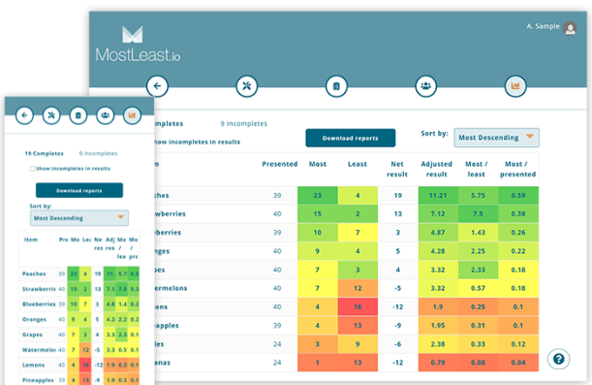

Caelus MostLeast.io
Presentation by:
Gautam Bhojwani, Jack Berris,
Kirti Vatsh, Miguel Del Rio
Notes:
kirti

Slide 2
Executive Summary
01
02
03
04
Sales Goal
Targeting to expand sales to 950 new licenses by focusing on the new business sector
Product/Market Fit
Identified small businesses and less technology efficient organizations
Budget Plans
Provide three different marketing plan budgets
Marketing Strategy
Create a cohesive marketing funnel encompassing different mediums to promote the licensing business model for the software
Notes:
kirti

Slide 3
Project Milestones
Understanding
Caelus’ challenge and opportunity
Identifying
target market and mapping the customer journey
1
2
3
4
Identifying
Competitors, SWOT Analysis
Go-to-market
strategy
Notes:
We’ve come a long way on this project, and we want to make a moment to recognize the key milestones that we built upon to get to where we are today.

Slide 4
Caelus Kyle’s Start Up
Kyle James, CEO
Jane Patterson, CFO
Joe Doe,
CMO
“I completely agree. I’ll research survey platforms tonight.”
“That’s a great idea. It would give us clarity on where to focus our efforts”
“Let’s run a survey to find out what our customers most and least prefer?”
Notes:
kirti

Slide 5
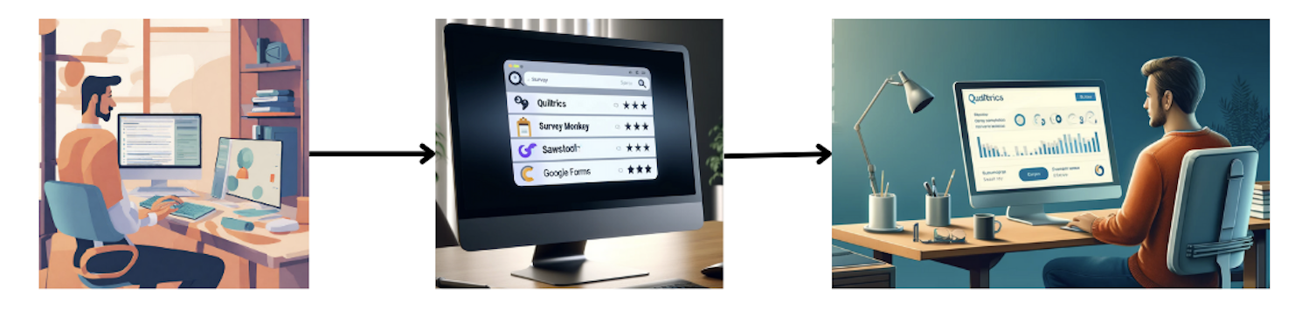
The Problem
Kyle wants to perform a MaxDiff Survey.
He searches for the easy to use survey software.
Search shows a list with names like Qualtrics, Sawtooth, Google Forms etc.
Kyle goes ahead and selects one of these softwares for his MaxDiff Survey although it was difficult to use and costs a lot.
Notes:
Gautam

Slide 6
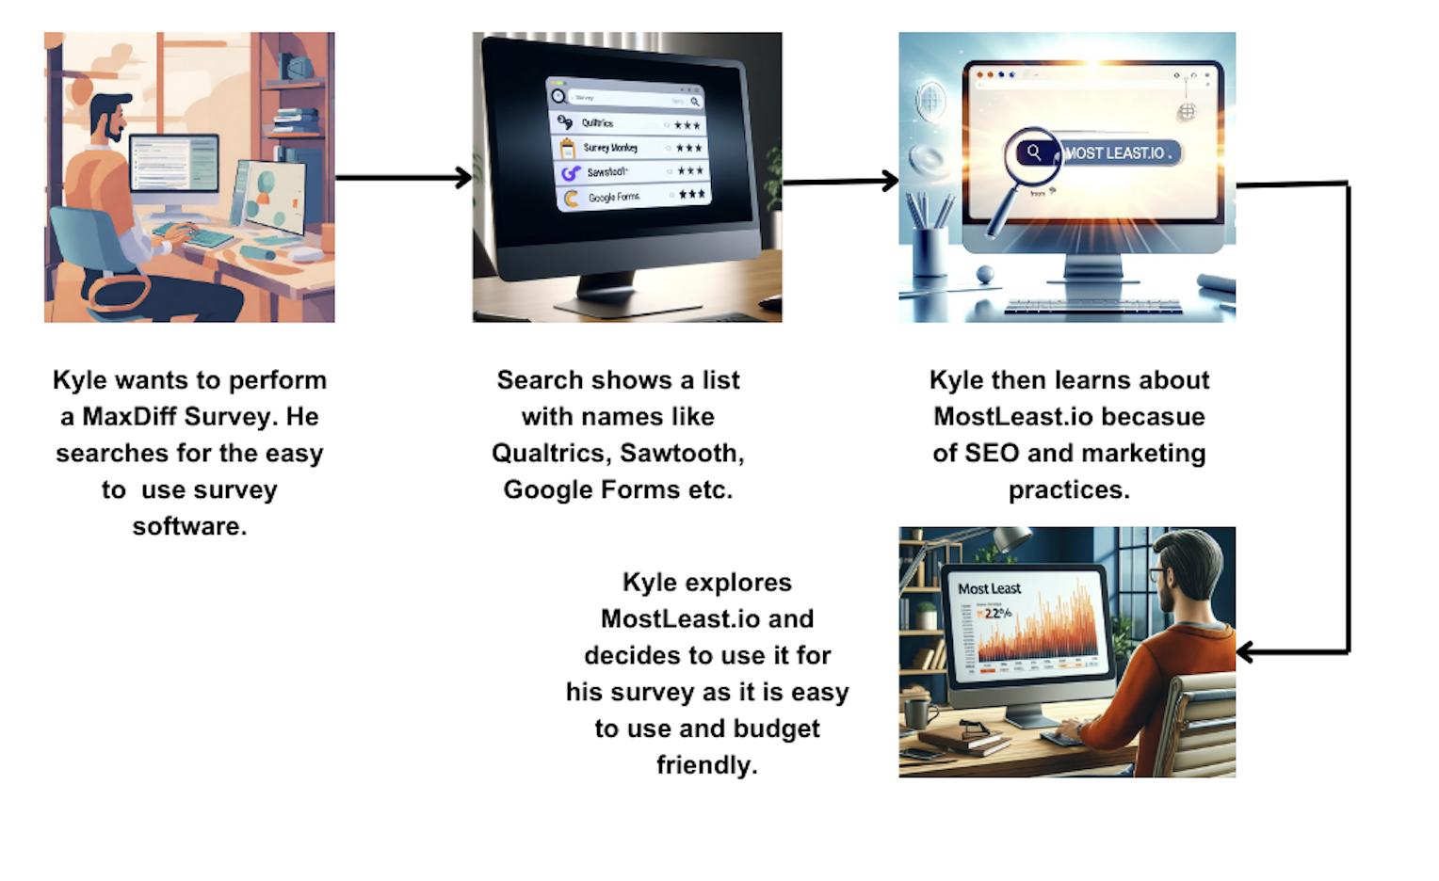
The Ideal Solution
Notes:
Gautam

Slide 7
For Kyle, Caelus stands out on Price
 | Price | Product Specs | Features | Services
Caelus
Survey Monkey
Google Forms
Sawtooth
Qualtrics
Notes:
Gautam

Slide 8
What Differentiates Caelus?
Ease of Use
Requires no training and set up is easy
Price
Enormous value
for the price
In-Depth Analysis
Easy to interpret data and heat map
Notes:
There are 3 main things that differentiates Caelus from it’s competitors.
It’s super easy to use.
It’s enormous value for businesses for the price that they will pay
It’s provide you a heat map that is 10x easier to interpret than any other survey results platform out there

Slide 9
STP Analysis
Segmentation
Targeting
Positioning
Small to Medium sized non tech-savvy businesses
Conferences, Sales calls, Media advertising
Premium version of Google Forms/SurveyMonkey,
For businesses striving to go to the next level in analytics.
Notes:
MIguel

Slide 10
Pricing Model
Annual Subscription of $749
Price for Target Niche
45K
Scalable Business Model
Notes:
MIguel

Slide 11

Trident Strategy
SEO/Social Media
Sales Team
Conferences
Outsource to Marketing Agency
In-House Cold Calling & Promotion
Attend events and pitch idea to early adopters
Notes:
MIguel

Slide 12



Agency Options
SEO & Google Ads
45K
SEO, Google Ads & Social Media
Notes:
John

Slide 13


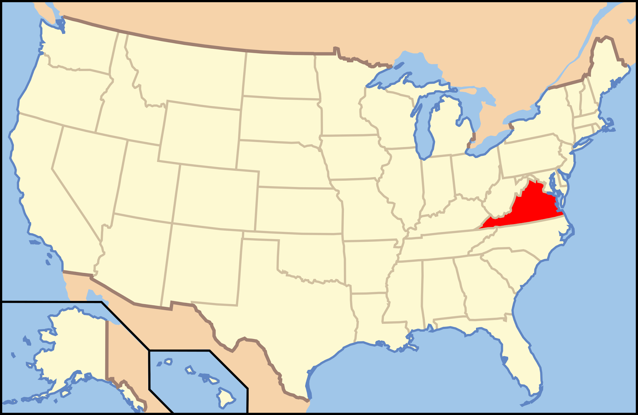

Conferences
Joint Statistical Meetings - Portland, OR
International Conference on Establishment Statistics - Glasgow, UK
Symposium on Data Science and Statistics - Richmond, VA
TechCrunch Disrupt - San Francisco, CA
Config - San Francisco, CA
Notes:
John

Slide 14
Conclusion
Pilot Trial Phase
Trident Strategy
Continue current services
Notes:
Miguel

Slide 15
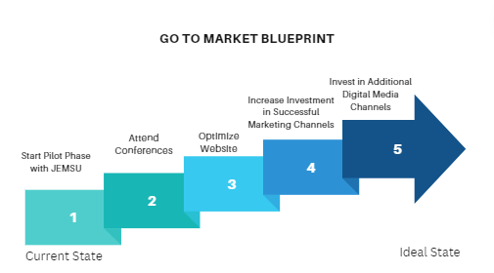
Next Steps
Notes:
John

Slide 16
Questions?

Slide 17
Appendix

Slide 18
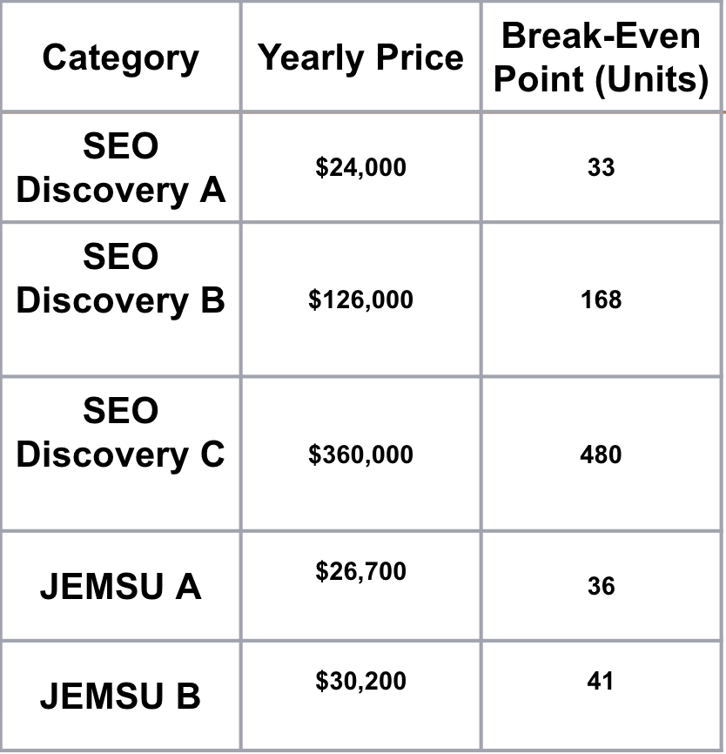
Appendix 1-SEO Options
45K
Notes:
John

Slide 19
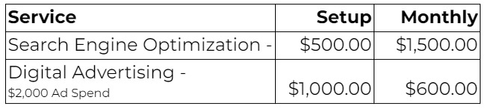
Appendix 2 - JEMSU Bid 1

Slide 20
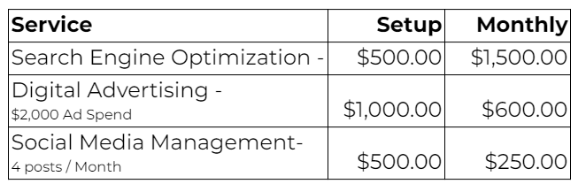
Appendix 3 - JEMSU Bid 2

Slide 21
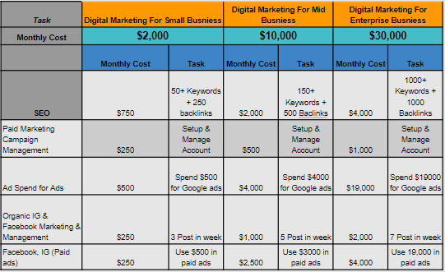
Appendix 4 - SEODiscovery Bid 1

